Slide 1
PROBLEM STATEMENT
How can HardCopy help book owners to monetize the books lying in their shelf space by lending them to neighbors and making the use of unused books.
How can HardCopy help book readers(IT Employees) to borrow & read books at low cost by solving the issue of purchasing books which are used once.

Slide 2
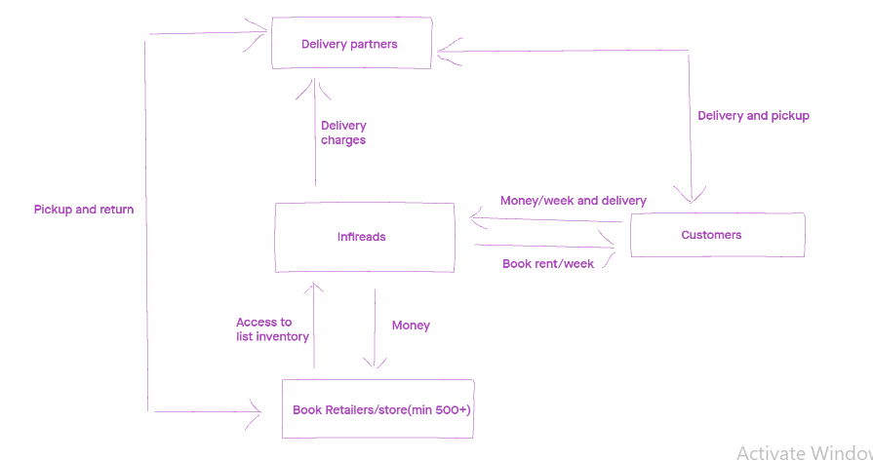
MONEY TRACK

Slide 3
MARKET RESEARCH
SECONDARY RESEARCH
India's book market is valued at 261 billion rupees ($4bn) according to a December 2015
According to 2019 survey, 28.9% of India’s population prefer to read physical copies of books.
Over 1500 fiction books get published in India every year, educational books, publishing is a $6.76 billion sector expected to grow at an astounding 19.3% until 2020. This means almost 250 books are published per day.
India is the second largest English-language print book publisher in the world with over 9000 publishers.
Organized book retail constitutes of 7% of total 3000Cr retail Indian Book Industry and is expected to grow by 15% a year.
PRIMARY RESEARCH
We have done a primary research on Second-hand book sellers.
On an average of 2700 books sold in 3 months by each second hand book seller.
Total revenue of each seller gaining 8 to 10 lakhs per annum.
Most outsourcing books is Academics and novels
No renting is provided by them.
Books are not delivered at doorsteps .

Slide 4
COMPETITION ANALYSIS
INFIREADS
Its a cheapest book rental commercial application in Bangalore
Connecting users with minimal of 500+ books
ZERO deposit | No Membership Fee | Home Delivery
It is like a free online library that you can browse without going to nearby bookstores or libraries
Currently 5000+ downloads in play store

Slide 5
PERSONA DEVELOPMENT
Interviews
We did 11 persona interviews to identify their motivations and what persona really need from us.
Don’t like to read on screen at any cost.
Likes to collect Romance/Love/Thriller fiction genre and Academic
Likes to use Technology-Online Purchasing
Purchase decisions based on suggestions & Recommendations
Once started to read, must complete any cost ASAP depends on book
Likes to purchase paperback on online/Offline.
Prefers eBooks for academic/Office purpose as they are portable.
Purchase decisions based on reviews & recommendations from friends.
Purchasing based on Author’s previous work and type of genre.
In some case reads first chapter and decides to buy.
Likely to complete a book in 2days if no external disturbances involved.

Slide 6
SURVEYS AND PERSONA DESCRIPTION
Surveys
We have done a Survey on 54 Members.
55.6% of people have habit of reading books
63% are interested to read books via hard cover or paperback
50% people couldn’t afford to buy their desired books due to high price
83% people had showed interest to rent a book instead of buying
71.4% are interested to provide their unused books to renting purpose
https://forms.gle/V8DpNg1qn5nSZGDe7

Slide 7
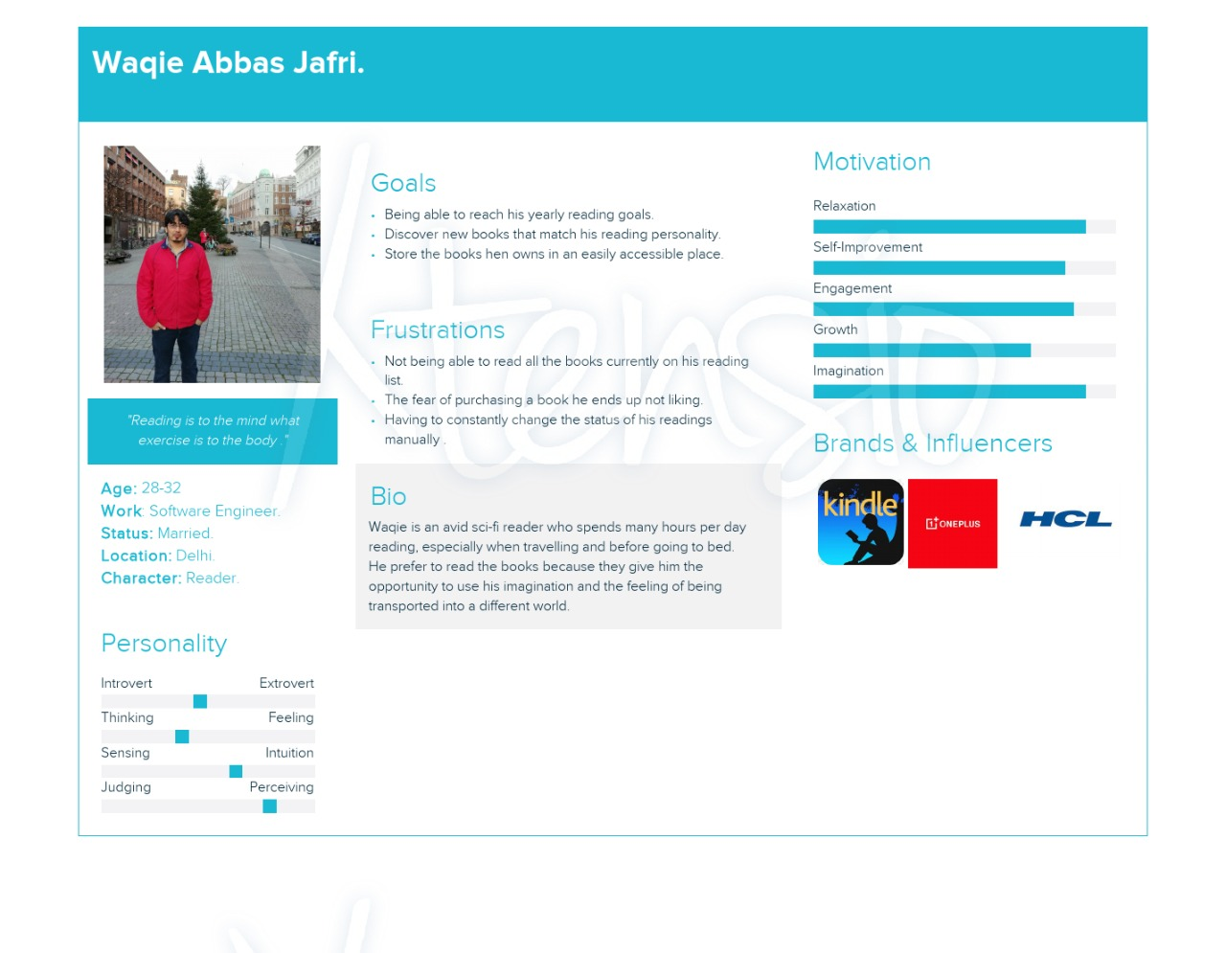
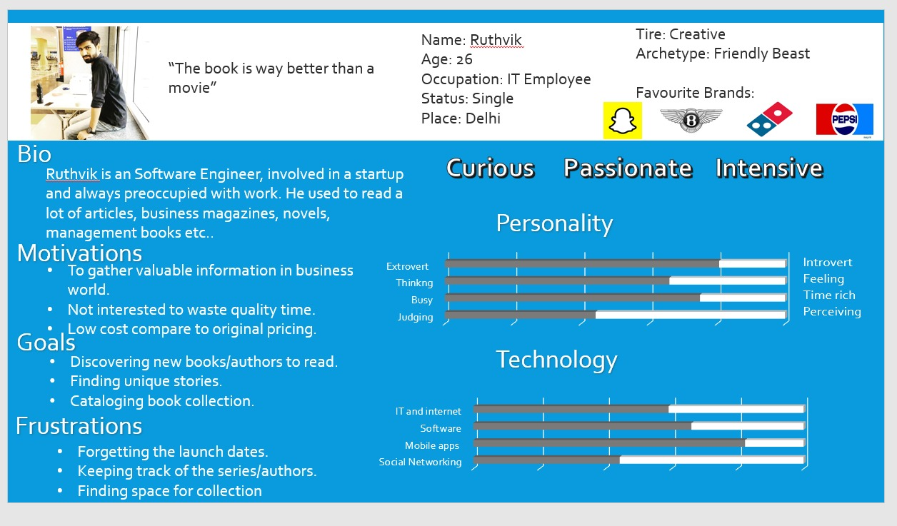
USER PERSONA

Slide 8
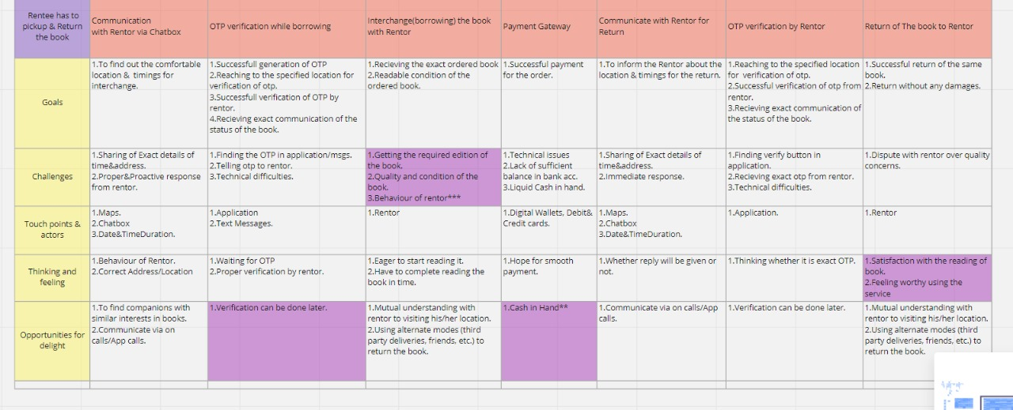
CUSTOMER JOURNEY MAPPING

Slide 9
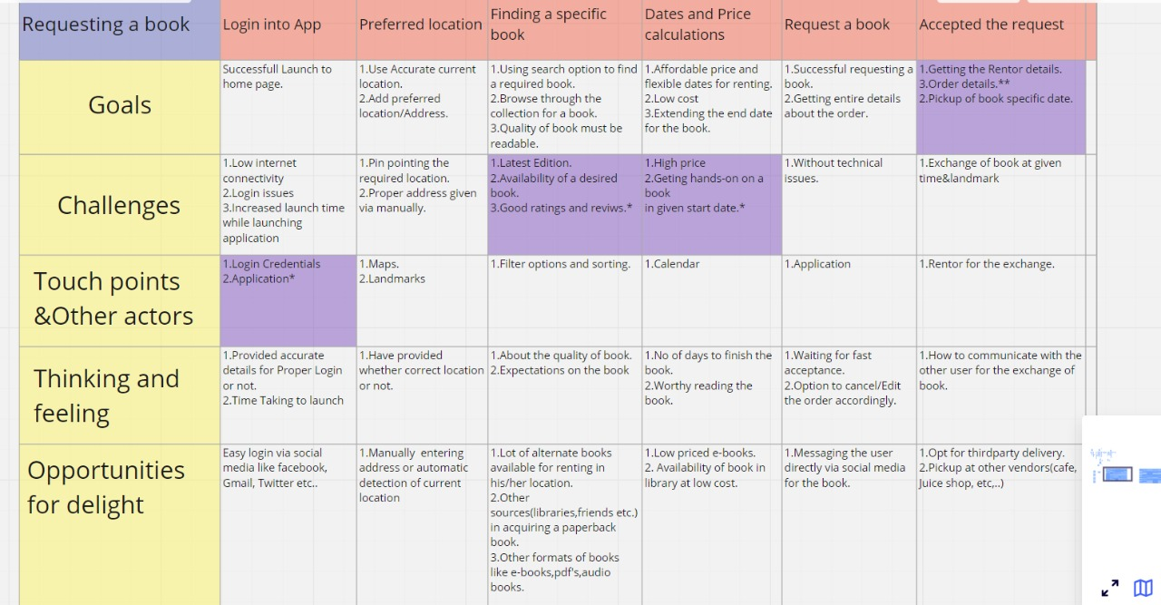

Slide 10
PAINS AND GAINS
Not interested to pay high price.
Maintaining a whole rack of books.
Pileup of paperbacks purchased and takes time to obtain interest to read them.
Eyestrain while reading for longtime on screen but adjusted because of modes given reading mode, night mode in gadgets.
Wait till prices come down for a specific book if hefty prices.
Takes more time to read in home because of many distractions.

Slide 11
ASSUMPTIONS
IT employees will provide books for renting easily to who can't purchase new copies.
People are willing lend their books through our platform to earn some monetary benefits.
Readers are willing to share their books to large community
Users will lend books easily to those who are in same location as them.
Reader will borrow book at a low cost from other users instead of buying it.
User will provide proper his/her details and social media profile before borrowing a book from other user..
People will save time, and they get many options
Those who are in towns they also can get books easily
IT employees can afford books on rent easily who can't purchase new books.
Hardcopy will provide fast delivery so that people get their order on time.

Slide 12
SHORTLISTED ASSUMPTIONS
Readers are willing to share their books to large community
1. Out of 54 responses, 71.4% are interested to provide their unused books to lend others.
Reader will borrow book at a low cost from other users instead of buying it.
1. 50% people are not interested to buy their desired books due to high price.
2. 83% people had showed interest to rent a book instead of buying.

Slide 13
MVP PLAN
As per our assumptions we have choose
1. Is the customer willing to buy your product / service?
2. Does the product / service help customer to solve the problem?
As per these assumptions we have built MVP
1. Prototype - draft 1
2. Poster
3. Video

Slide 14
MVP RESULTS

Slide 15
LEAN MODEL CANVAS
PROBLEM
How can HardCopy help book owners to monetize the books lying in their shelf space by lending them to neighbors by solving the use of unused books.
SOLUTION
A mobile platform where unused books by their individual owners can be kept online for renting to others. By this we are able to provide books on rent per day basis to others and whoever made books available can earn Value on the bookings.
UNIQUE VALUE PROPOSITION
Generate the value to other book readers by using their own inventory (books)

Slide 16
UNFAIR ADVANTAGES
Monetization of inventory & Proper tracking of interchange process of a book between both users.
CUSTOMER SEGMENTATION
IT employees (book readers)
EARLY ADOPTORS
Paperback book readers
Book Owners who wish to lend their books
CHANNELS
Digital marketing, posters in public libraries, social media (LinkedIn, instagram)
HIGH LEVEL CONCEPT
Uber for books

Slide 17
KEY METRICES
No of books exchanging
No of books uploading in our app, customer reviews
EXISTING ALTERNATIVES
Infereads
COST STRUCTURE
App development, Operational cost and Marketing cost
REVENUE STREAM
Commission on each order
Promotions (Ads)

Slide 18
RESOURCES
Secondary research
https://drive.google.com/drive/folders/1TNqu5Swqy8hplT_3myW0psVpDDx_MUuH?usp=sharing
Primary Research
https://docs.google.com/forms/d/e/1FAIpQLSe5P4a2_8-KYDgyU4_mD5Ol-V3oievdxk3OfRsfOM0DLvFXqA/viewform

